Slide 1
Jump Start Workhop:
Refresh and Revitalise
Committee Chair Extraordinaire – How to support your President and Be Effective!

Slide 2
Responsibilities of Committee Chairs:
• Learn about the club and about your specific duties
• When planning a project provide Committee budget information to the Board
• Keep a file and/or workbook defining the duties and objectives of the Project
• Make notations during the year on “how you did it” so your successor will have a clear idea of the pattern of work
• Prepare a written report for the Club’s annual meeting
• Emphasize and become role models in member recruitment
• Try to Attend IFF days, workshops and District Conferences .

Slide 3
Know your Committee
Do you have a Committee Profile?
What club activities is your Committee responsible for?
Who are your Committee Members. What are their strengths/ weaknesses.
Appoint a Secretary and Deputy Chair
Delegate

Slide 4
Conversations to have
Talk to your President – find out if there is anything you can focus on
Talk to the previous chair – what worked and what did not
If necessary, talk with Treasurer on how to prepare a budget
:

Slide 5

Conducting a meeting
Have an agenda
Keep control, allow everyone the opportunity to speak
Keep note of any action items and ensure these are followed up and completed
Call for any other general business at end of meeting
Review meeting minutes and ensure they are distributed

Slide 6


Slide 7
Setting a budget
What will you be spending money on? Remember such things as stationery, printing, postage, catering
How will you fund this project,
Grant application (who to)
From Club Funds
  From funds raised if a fundraising project., will seed funding be required from club funds?
How many people do you expect to attend if you are planning an event
Remember to always add a contingency for thing you forgot or under estimated.

Slide 8

Take plenty of photos:
Before – the activity begins
During – action shots
After – completed project if appropriate

Slide 9

Useful tools
District Website
International Website
Altrusa Service Database
Relentless Service database – 453 Ideas https://www.dropbox.com/scl/fi/0qjauta9m3etu2o3tm93d/Grow-Altrusa-Through-Service-Project-Ideas.pdf?rlkey=e77wdowyqp6w4aazusryrfner&dl=0
Other club members
Attendance at IFF Days and Conferences

Slide 10
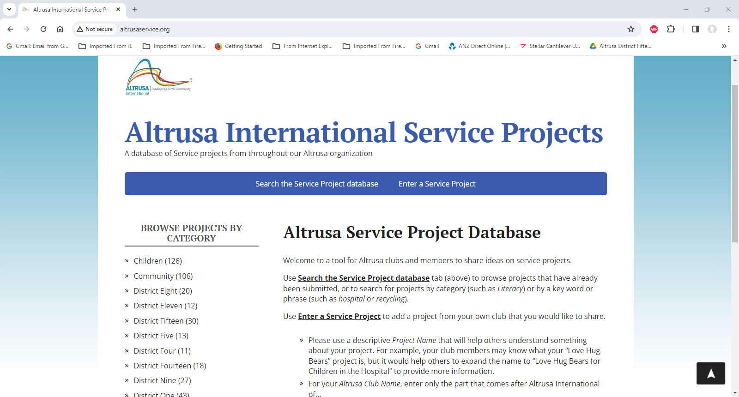

Slide 11
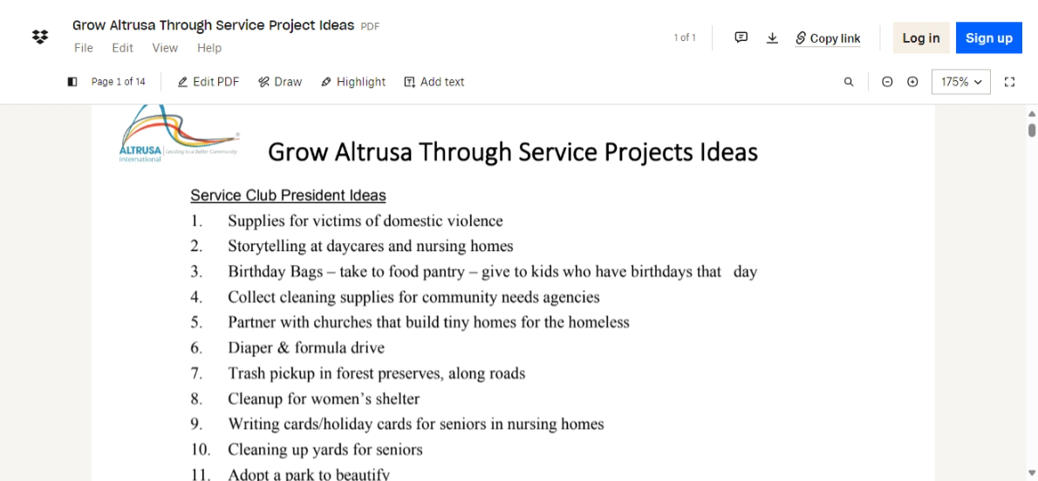

Slide 12
