Slide 1

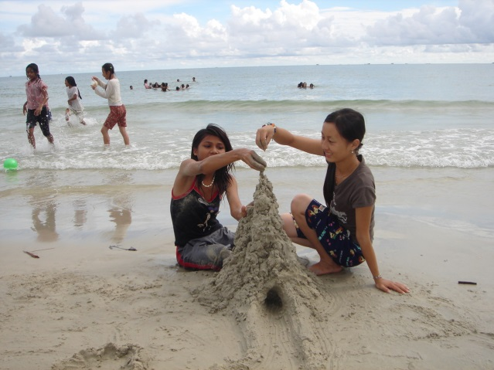
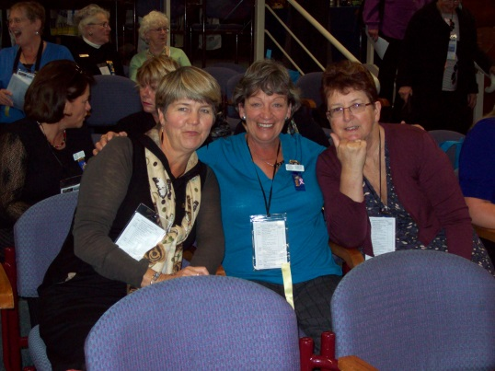
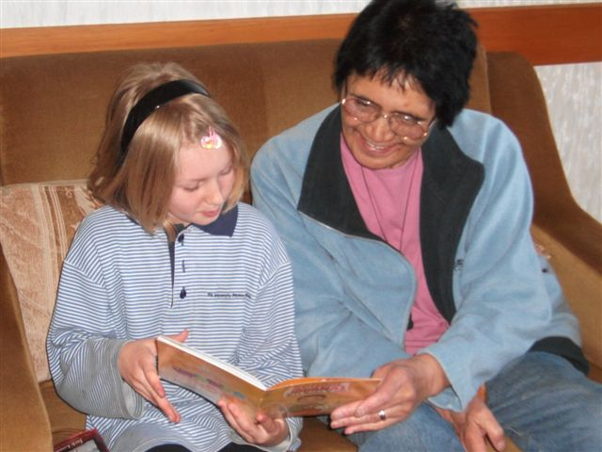
Altrusa International of
INSERT CLUB NAME Inc
Charter Date
New Member Orientation

Slide 2
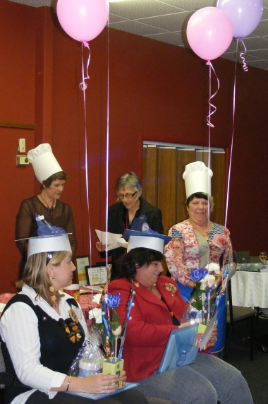
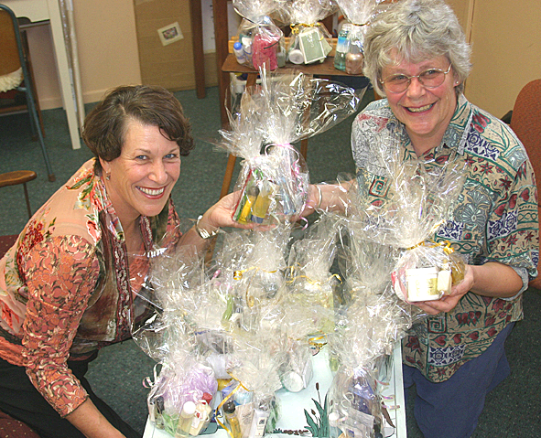

getting acquainted
Introductions – share name, work, home, family
Why you joined Altrusa
What you plan to contribute
How you hope to benefit

Slide 3






ORIENTATION AGENDA
Altrusa International of INSERT CLUB NAME (and logo below)
Altrusa International District Fifteen
Altrusa International, Inc. and Altrusa International Foundation, Inc.

Slide 4
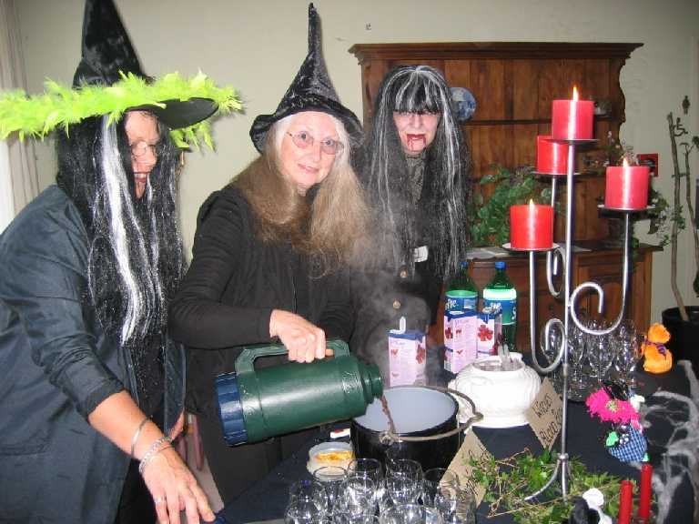
Our Club’s Logistics
Meetings
  WHEN
  WHERE
  COST
  RSVP/APOLOGY PROCESS
    PROCESS FOR GUESTS
  FORMAT OF MEETINGS (BUSINESS/ PROGRAMME ETC)
Scheduled Events
  Fundraisers
  Make a Difference Day
  Socials
  AGM (June Meeting)
  Xmas Party

Slide 5
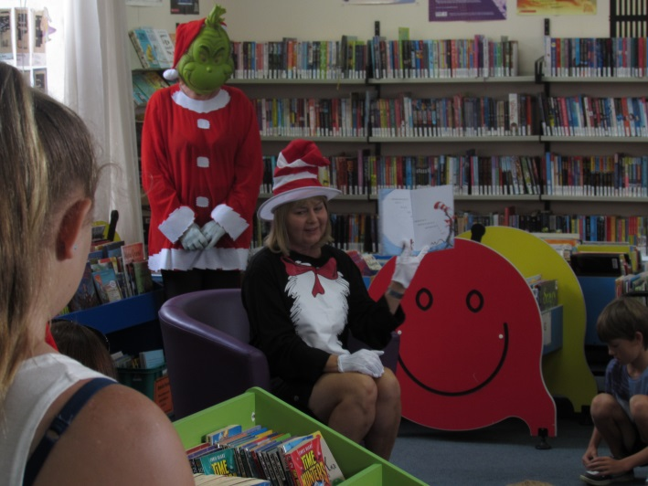
more about Meetings
Discuss and encourage attendance.
Preparing for club meetings.
Process for bringing a guest – reservation, cost, etc.
Describe how reservations work

Slide 6
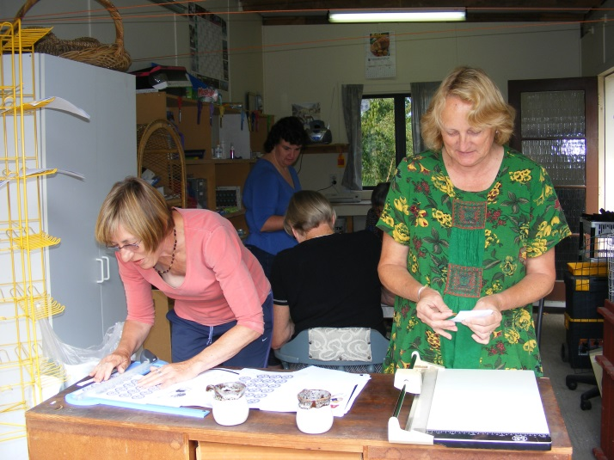
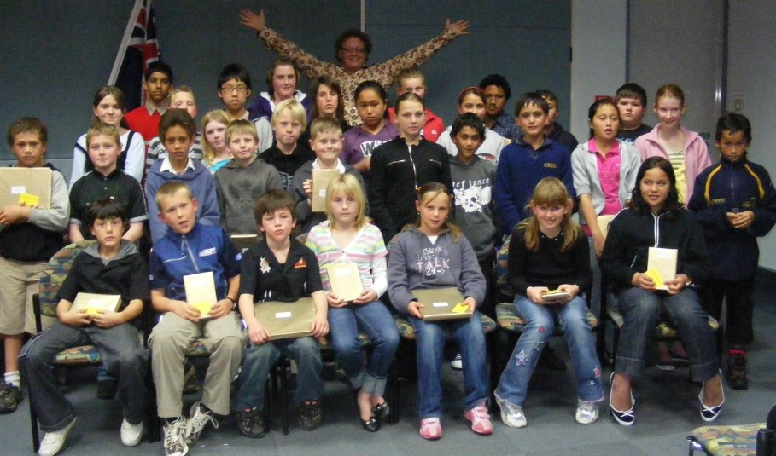
Club’s activities SERVE Community
Projects are organised by a committee and involve whole of club participation
  List of 3 or four recent projects to talk about

Slide 7
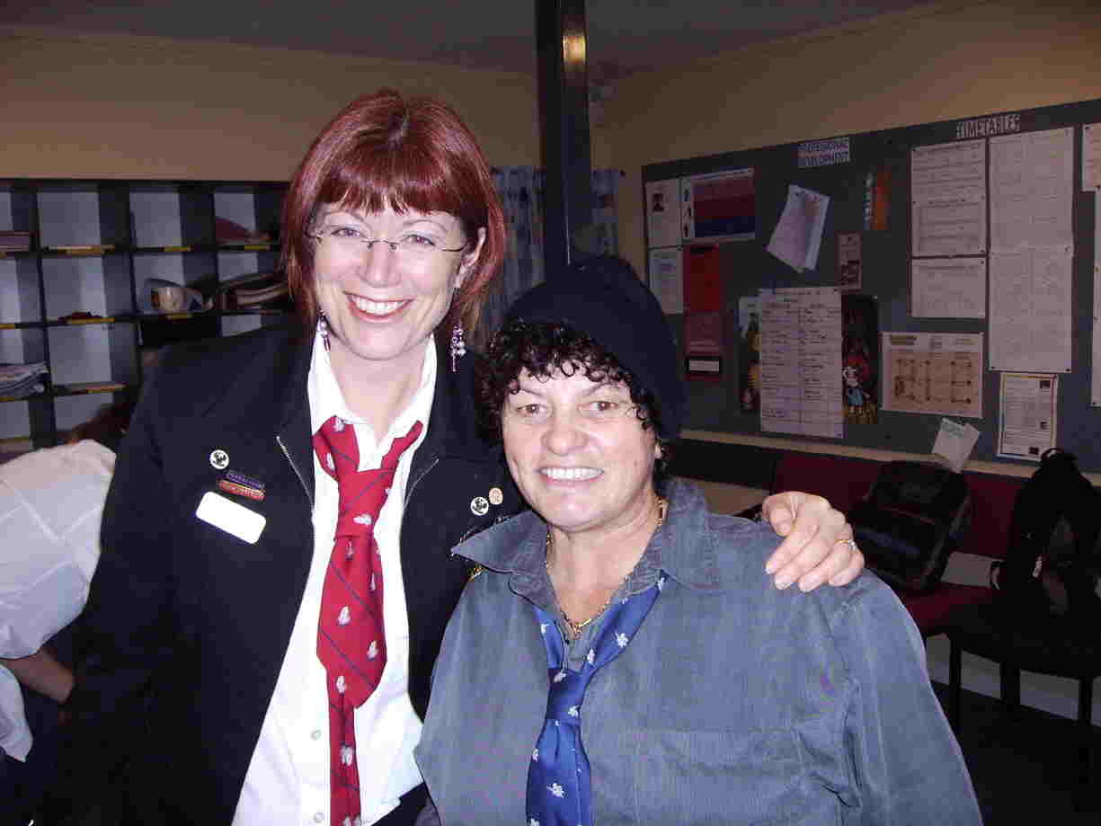
Committees
  Describe how committees interface with Board
  How many committees.
    List the committees you have
  What personal and career skills are used/developed (i.e., public speaking, project management,
  financial management)

Slide 8
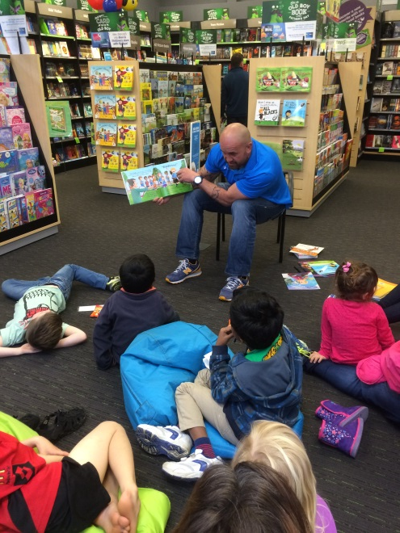
Club leadership – serve on board
Altrusa business year June 1 – May 31
Bylaws/Policies dictate Club governance
Officer nomination process
Board meetings – When and Where
What does the Board do?
January | Nominating Committee forms
February | Nominees sought
March | Slate presented & Members vote

Slide 9
Club board
President¹
President-Elect
Director(s)
Secretary
Treasurer
Immediate
Past President
Vice President
¹Has previously served 1 year as Board member.

Slide 10
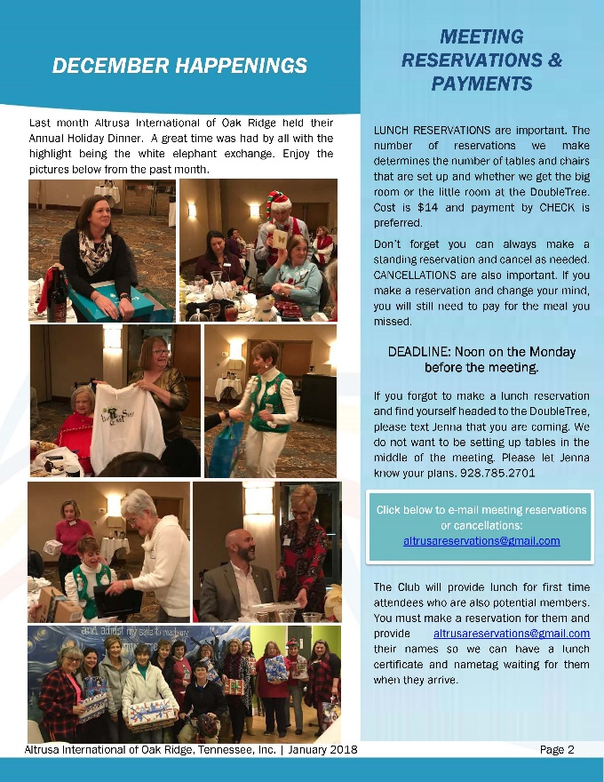
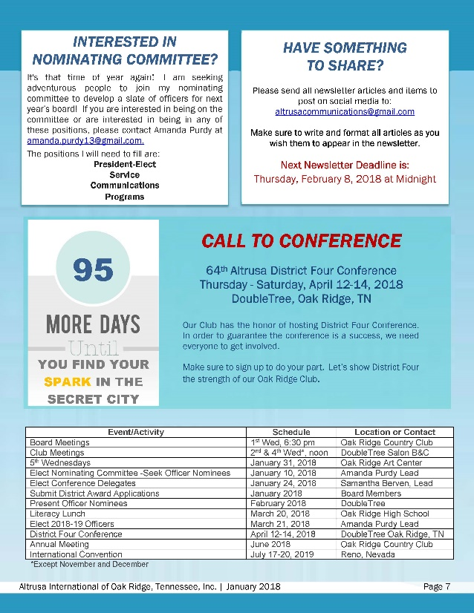
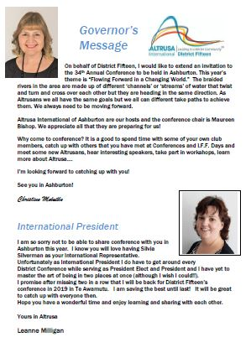
COMMUNICATE COMMUNICATE COMMUNICATE
Yearbook: Keep personal contact information current.
Internet: www.altrusa.org.nz
International web: www.altrusa.org
Facebook: INSERT FACEBOOK PAGE LINK
Newsletter: Emailed Monthly
Agenda : Emailed Monthly
E-mails: Distributed via Club Secretary

Slide 11

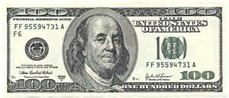
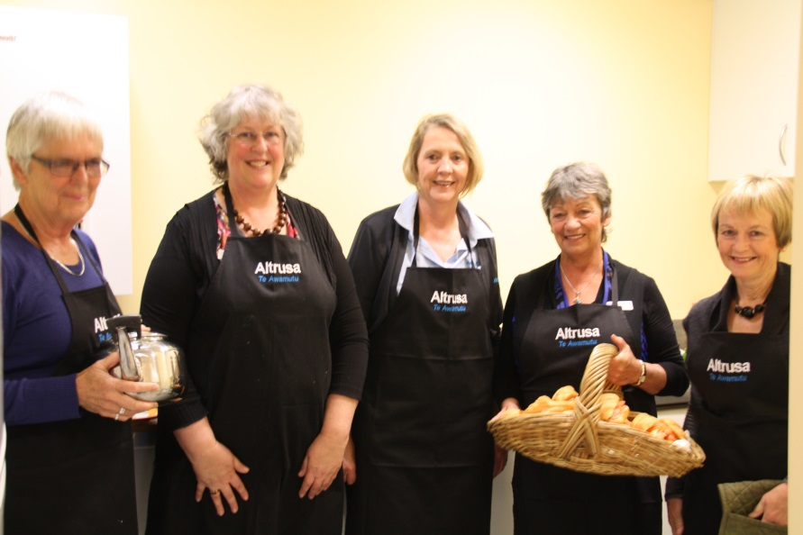
MONEY MONEY MONEY
Club operations budget managed by Club Board
Income from dues, fundraisers
Expenses for projects, yearbook, Conference and Convention attendance, programs
Donations & Project distributions
Club is a registered charity.
Donations are tax deductible.

Slide 12
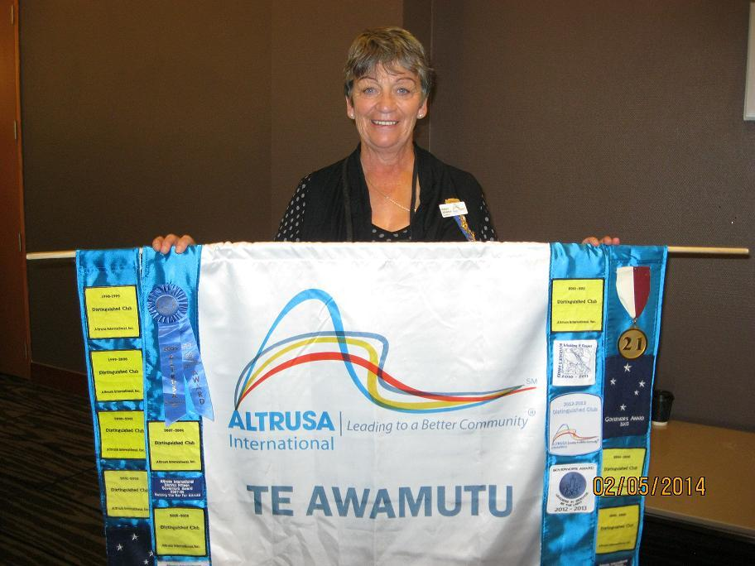
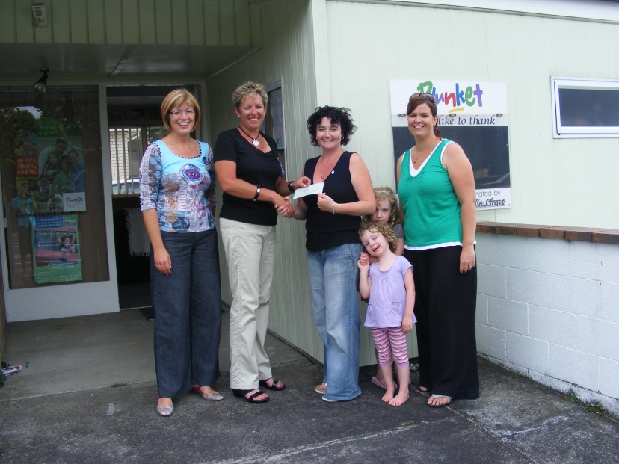
Become an active member
Attend meetings
Join committees
Support fund raisers
Attend working bee events
Attend social events

Slide 13

Club part of Larger organizations
Club
Club Members
Local Projects
Yearbook
Monthly newsletter
District Fifteen
New Zealand
17 Clubs
353 members
District Projects
Annual Conference
District Service Bulletin (DSB) – Kiwi Altrusan
International
Founded 1917
8 Countries
14 Districts
278 Clubs
6749 Members
Biennial Convention
The Altrusa Compass

Slide 14

District Fifteen
Board serves 2-year terms. Governor leads.
Biennial Theme – Refresh & Revitalise
Quarterly Publication – The Kiwi Altrusan
Next Annual Conference is in Invercargill
  Delegates represent Club.
  Club achievements recognized.
Topical Workshops

Slide 15
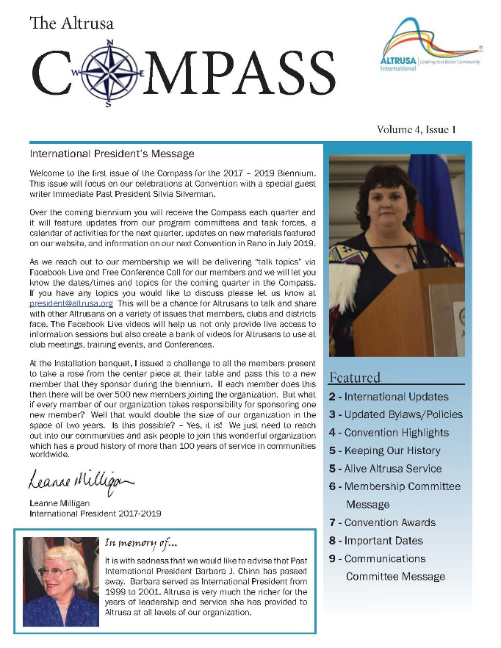

International
Board serves 2-year terms. President leads.
Quarterly Publication – The Altrusa Compass
Biennial Publication – The International Altrusan
59th Convention, Quebec City, Canada July 2025
  Delegates represent Club.
International office with staff, Chicago, IL.
Comprehensive website many great references.

Slide 16
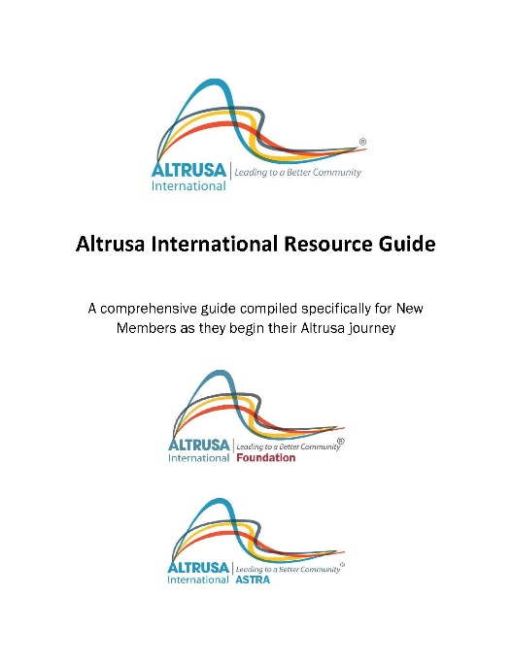
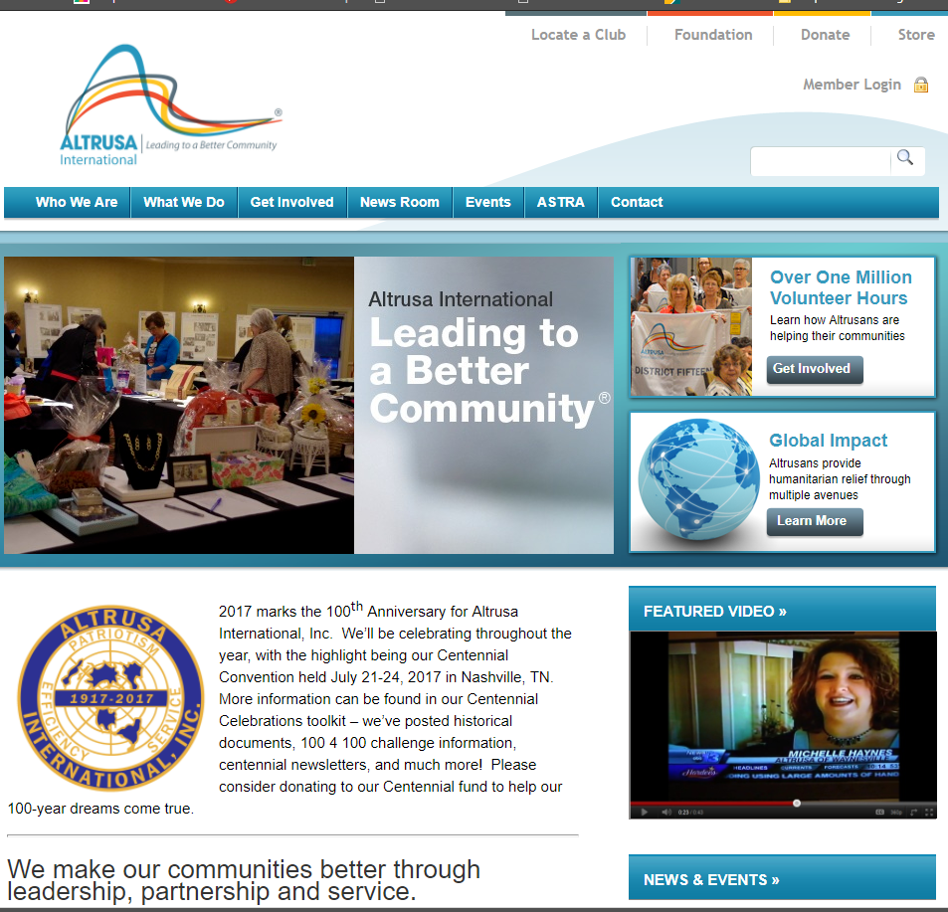
Altrusa references
Club Yearbook, International Website: Index & Publications
  Altrusa International Resource Guide
  Altrusa: ALTR for altruism + USA
  Key: Amity, Loyalty, Talent, Reciprocity, Unity, Service, and Achievement
  Motto: Patriotism, Efficiency, Service
  Principles of Altrusa. Mamie L. Bass. 1921
  The Altrusa Tradition. 2017
  Responsibilities of Membership

Slide 17

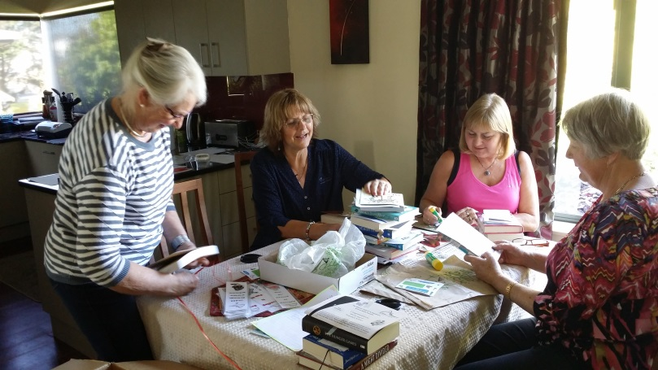
Wear your Altrusa pin
The Altrusa pin is always worn proudly over the heart, affixed directly onto a blouse, sweater, suit lapel or dress. Out of respect, the pin must never be worn, elsewhere on person or as a garment decoration. Altrusa International Resource Guide. 2014.

Slide 18
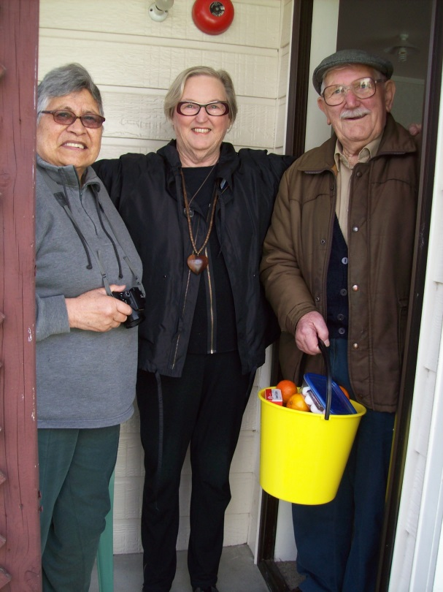
TIPS
If you don’t know – ask your sponsor, committee chair, board member, me.
Membership renewal process begins in April. Avoid late penalties.
Discuss reservation requirements.
Get involved. Volunteer.
Meet new people. Mixed up seating.
Keep contact information current – on website and
with Membership Chair.

Slide 19
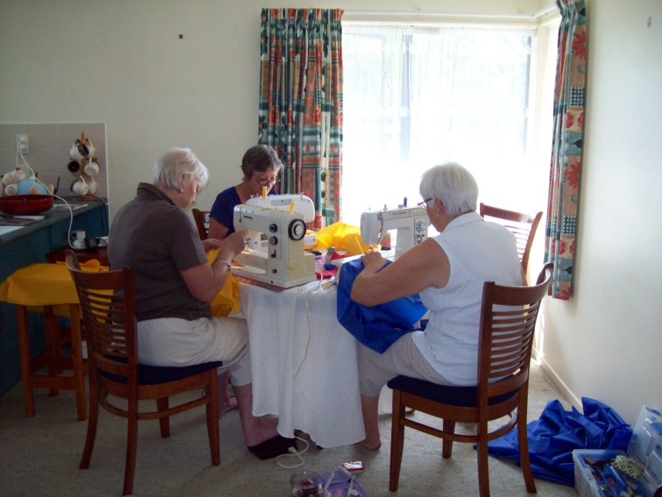
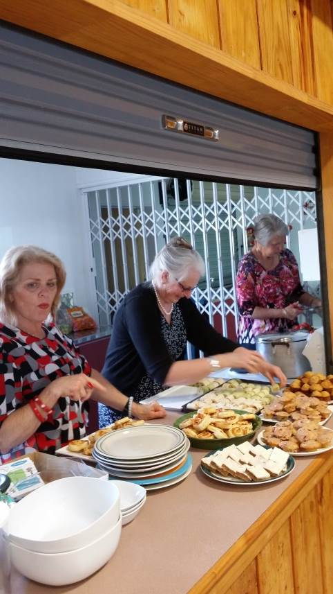
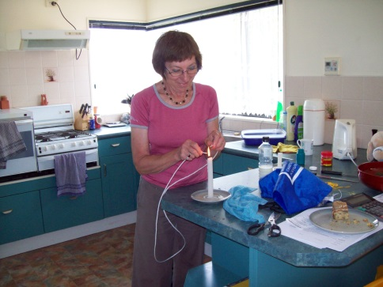
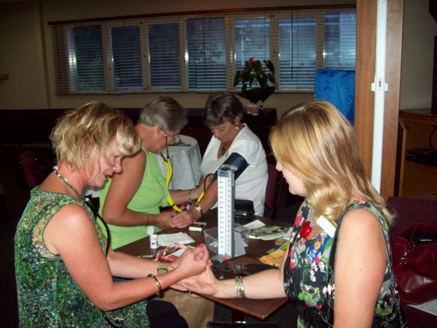
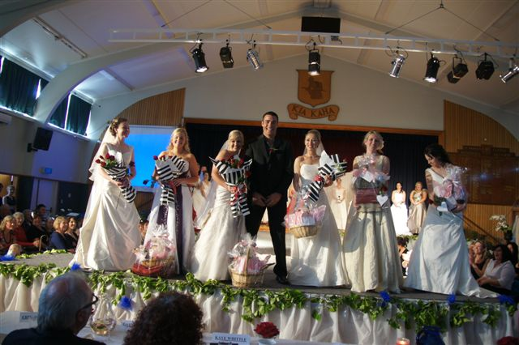
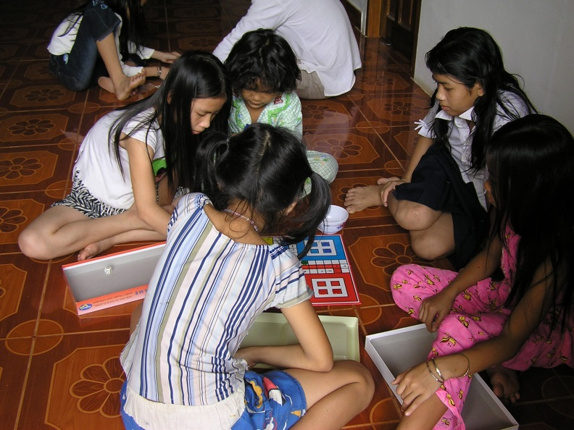
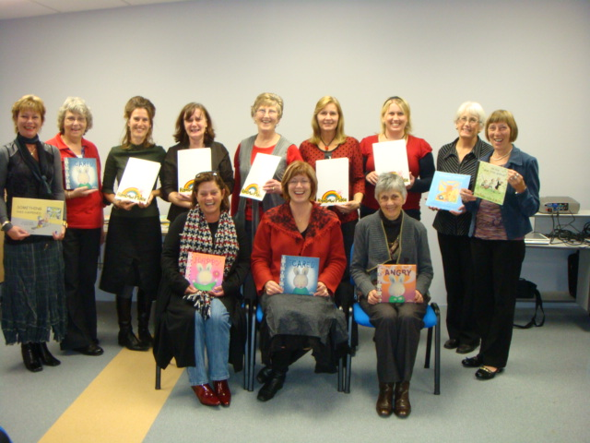
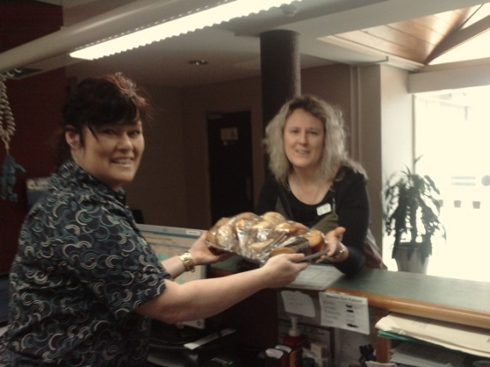
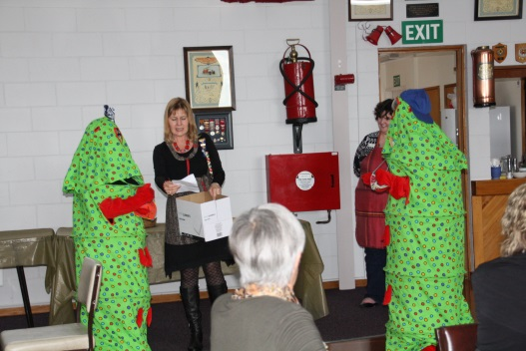
THANK YOU

