Slide 1

2024 Conference
Welcome to Altrusa District
TREASURERS WORKSHOP

Slide 2

What we will be discussing:
TREASURER
WORKSHOP
AGENDA
Treasurer’s Calendar
General Responsibilities
Group Tally
Financial Responsibilities
Cyber Fraud
Resources

Slide 3

Treasurers Calendar
APRIL/MAY
Work with outgoing Treasurer to coordinate dues collection and payments.
JUNE
June 1: Dues for the year for both International and District are now DUE. Please do not pay District Dues before 1 June
June 15: DEADLINE for dues submission. Payments not paid by this date will be subject to $5 late fee per member on International Dues and 10% late fee on District Dues.
JULY
July 10: All dues must be paid. Unpaid members after this date are dropped from database. Dues after this date are subject to $10 reinstatement fee.
OCTOBER
Foundation Grants Program month, send in your Club donations.
DECEMBER
December 1: International Half-Year (half-price) dues go into effect for new members and remain in effect until March 31 to encourage new members to join.
MARCH
March 31: is the last day for International Half-Year Dues.
Half-Year Dues are applied to the current year’s membership. New members will be billed the full dues amount for the following year.
APRIL
New members paying dues between April 1 and May 31 receive full membership for the remainder of the fiscal year and the following year.
Send contribution to Foundation.
Work with incoming Treasurer.
This is in the TREASURERS GUIDE on the International Website

Slide 4

General Responsibilities
MEMBERSHIP RECORDS
Maintain accurate Club membership records including information on each member’s payment status, ID Number, email address, telephone number and primary address, in Group Tally and with the District Treasurer.
Update Club membership changes (including new members, dropped members or deceased members) monthly in Group Tally and with the District Treasurer.
Review club records on Group Tally prior to annual dues and make updates.

Slide 5
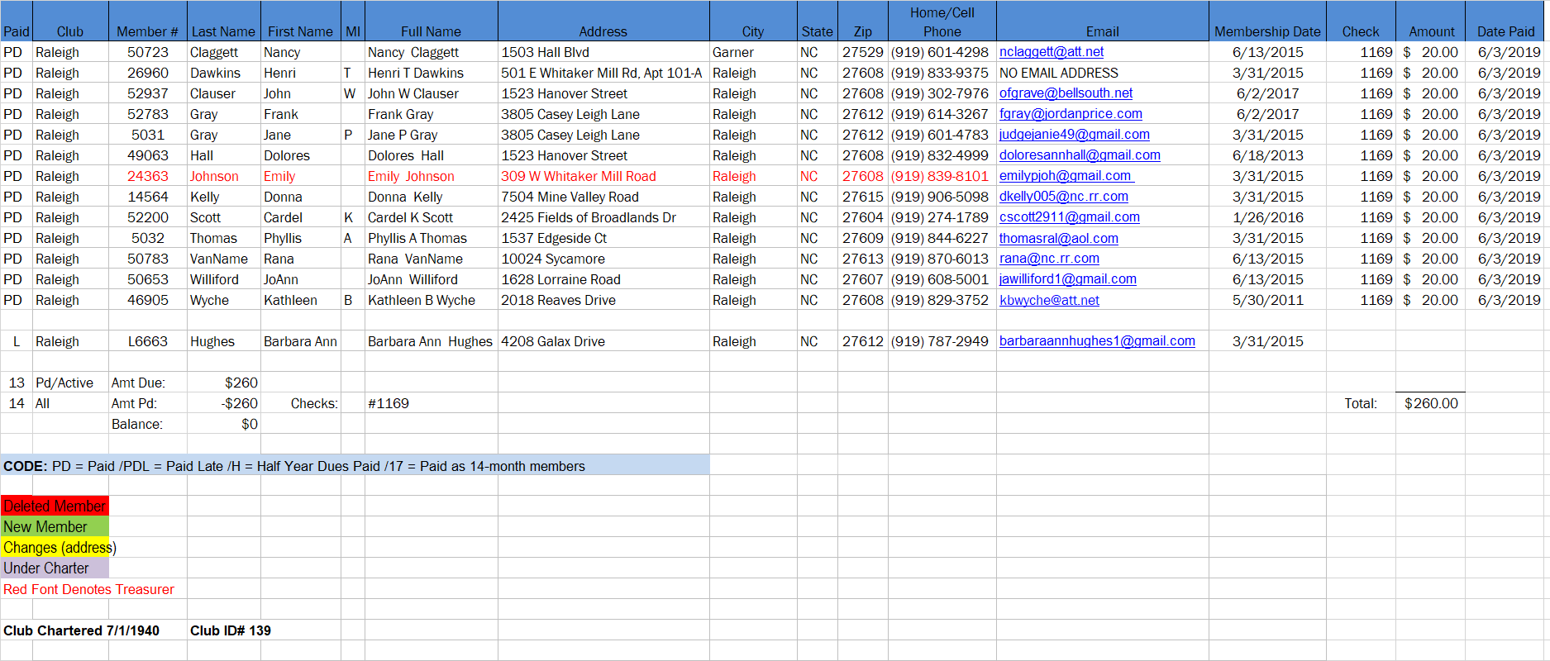
Membership
Records
SAMPLE:
DISTRICT CLUB MEMBERSHIP SPREADSHEET

Slide 6
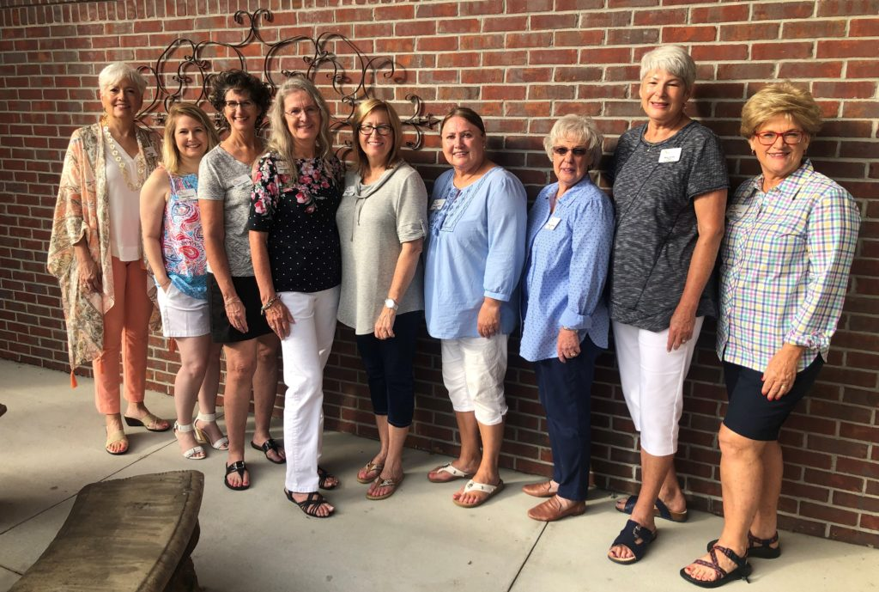
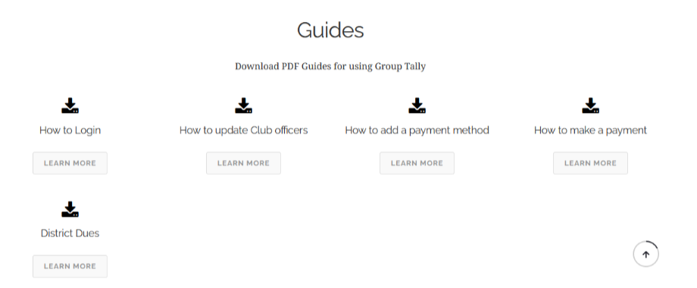
GROUP TALLY
MEMBER MANAGEMENT
To sign into the Group Tally platform for the first time, your email address must be in the system. Once you have obtained the Full Administrative rights, from your Club President or previous Treasurer, sign into Group Tally.
For more detailed instructions see the Group Tally instructional PDF guides and tutorials, located on the International Website under “Leadership tab”, scroll to “Club Treasurer” and “Group Tally Toolkit”.

Slide 7
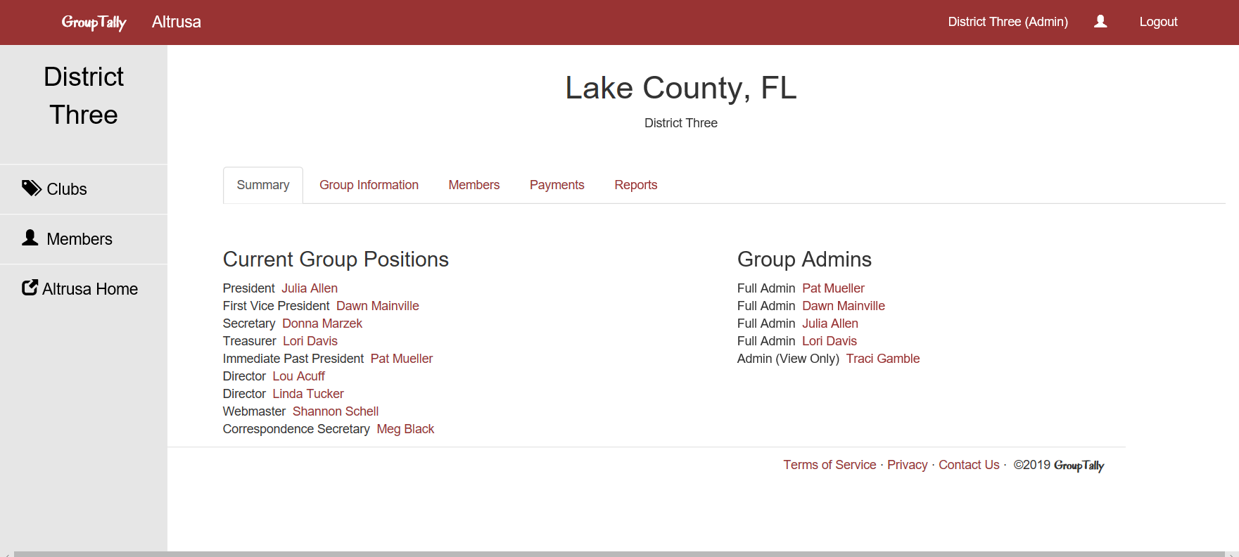
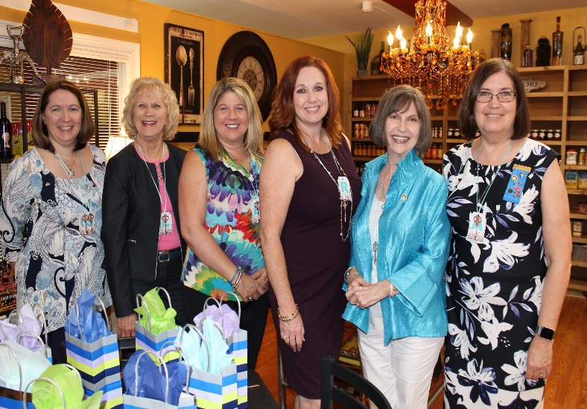
Logged in to your Club Page, will be your “Club Name” and “Current Group Positions” reflecting your club’s officers. Click on Members.
Updating
Club
Officers

Slide 8
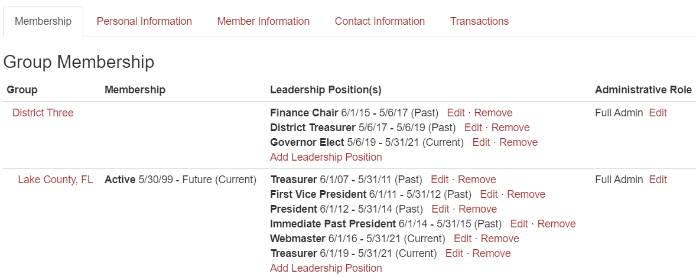
Click the name from the Group Positions list or by searching the name, click on it, and the member’s page will come up. Here you find information on what District and Club the member is a part of, as well as the dates and any leadership positions assigned to them, past and present. Click on the Add Leadership Position link.

Slide 9
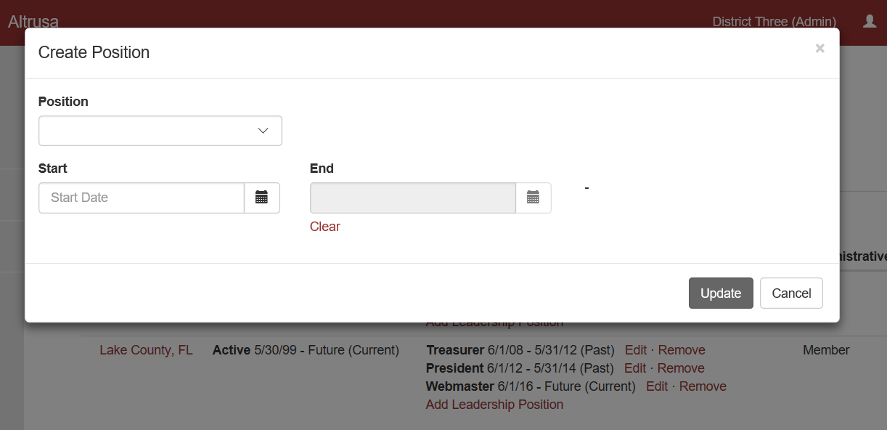
Click the Position drop box to select a position, and then enter the dates the member will hold that position.
THE DIALOGUE BOX WILL APPEAR
Once you click on Update, your newly assigned position will appear under the Leadership Position(s) heading. If it does not appear instantly, please refresh the page or log out and log back in, please do not repeat the process multiple times.

Slide 10
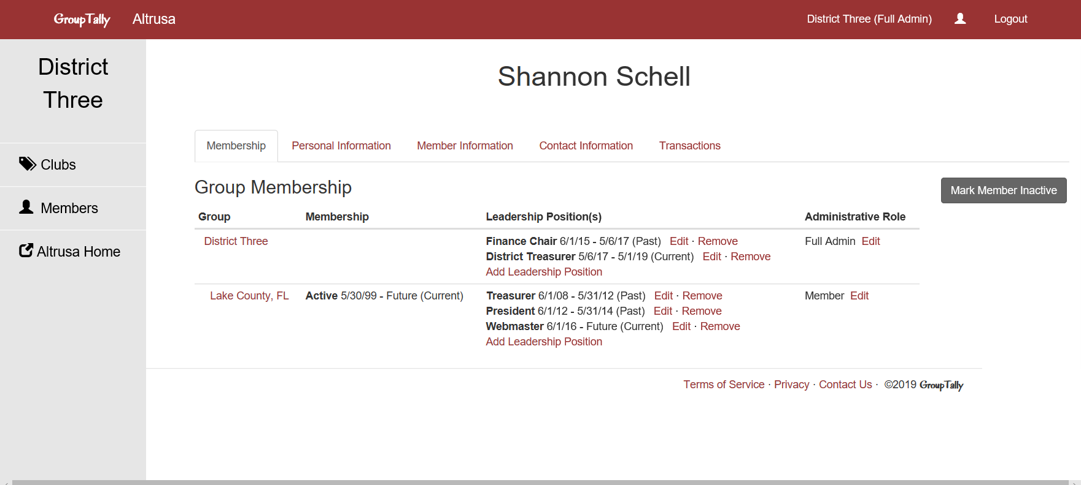
USE THE “EDIT” LINK TO ADJUST ROLES THAT ALREADY EXIST.
If member’s term has no end date, or needs to be adjusted,
use the edit feature instead of removing a position.
We would like past roles to remain listed so there is a record of positions each member has held.

Slide 11
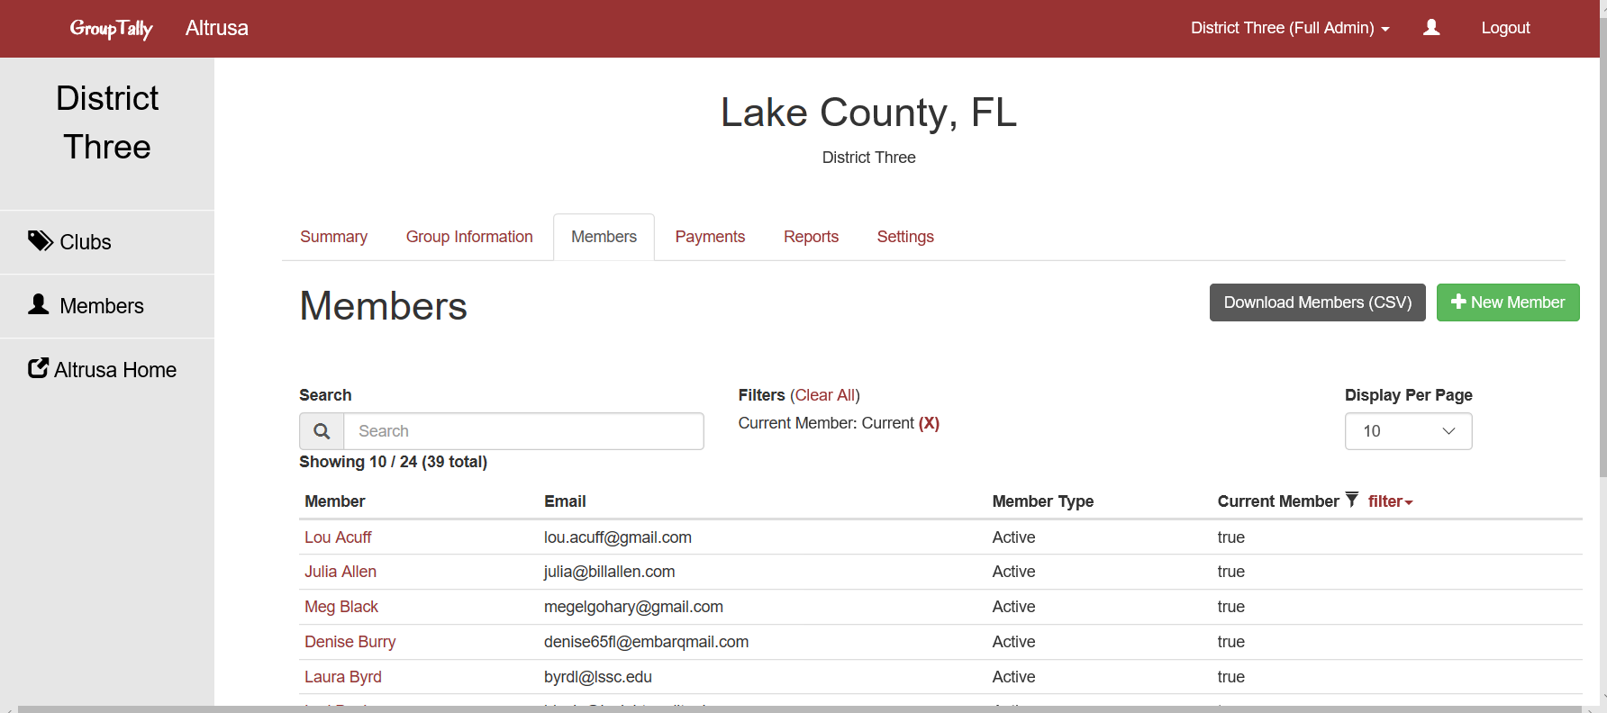

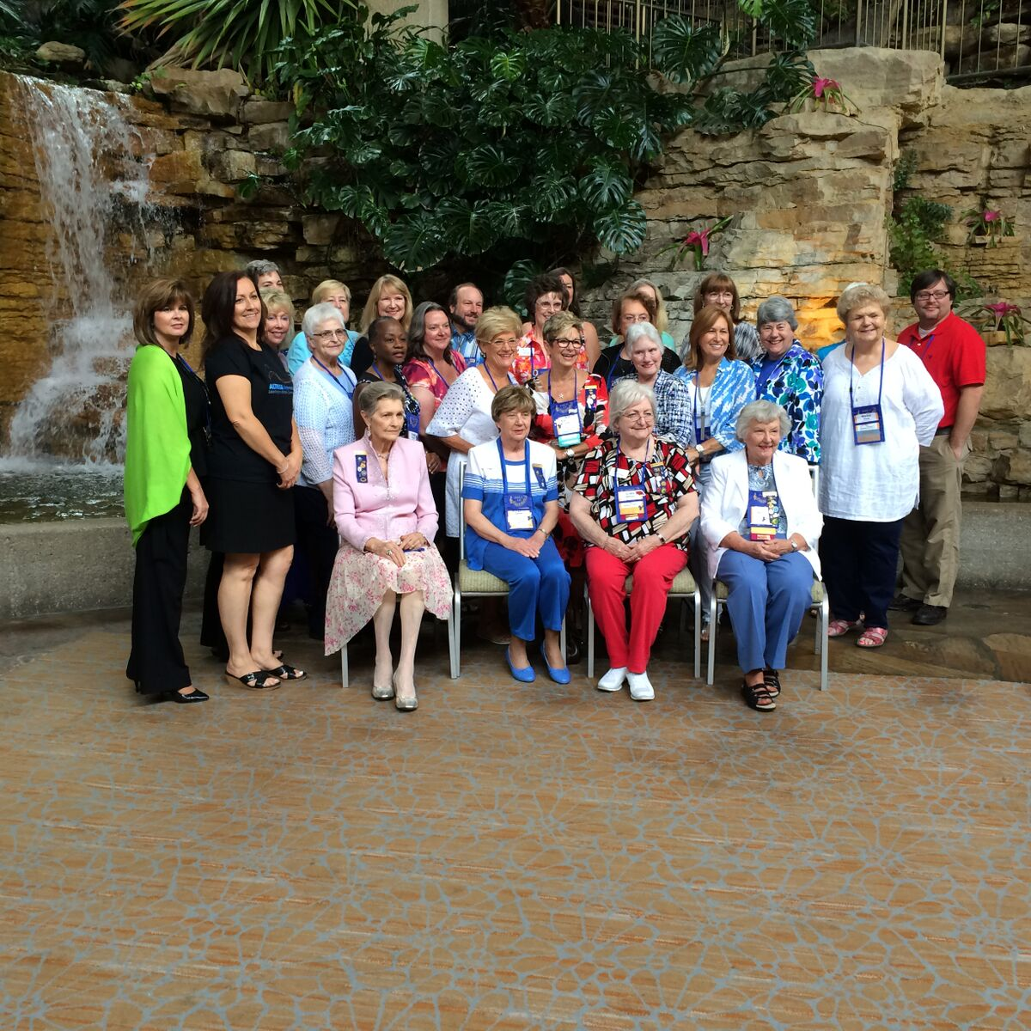
From Members page you can ADD a New Member
click on +New Member
Updating
Members

Slide 12
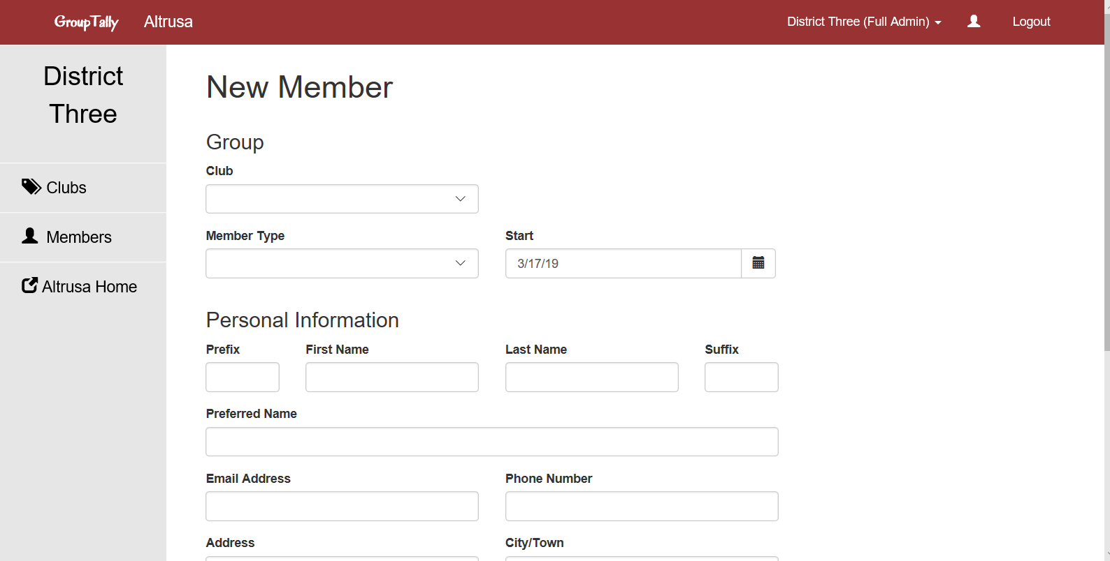
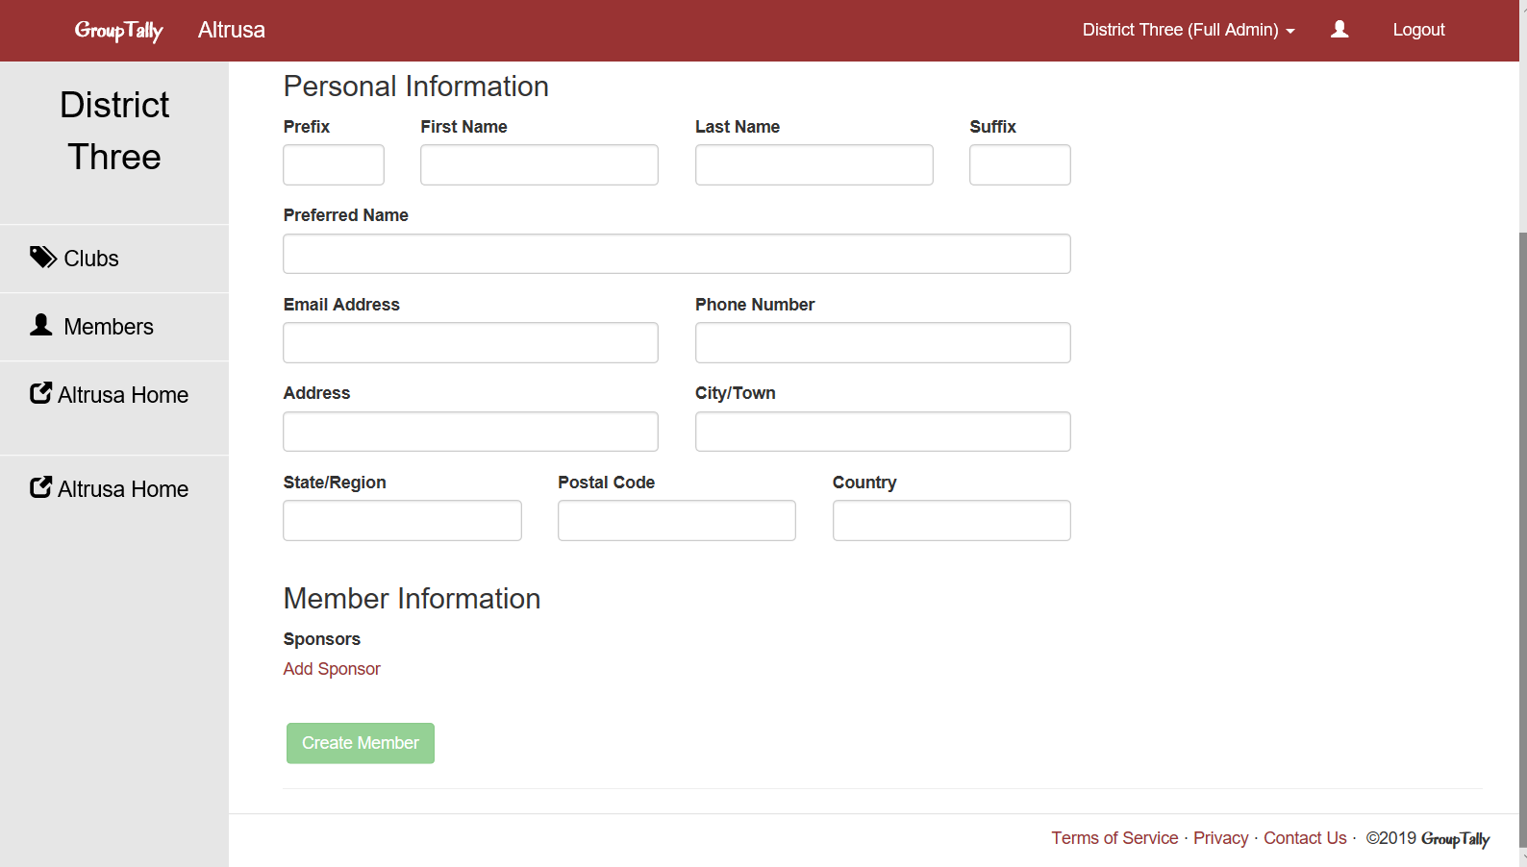
Simply fill
in the form…
Apply your club name
The drop-down choices for
Member Type are Active,
Affiliate and Young Professionals.
Please don’t forget to click
on Add Sponsor and input name
Finish by clicking
Create Member

Slide 13
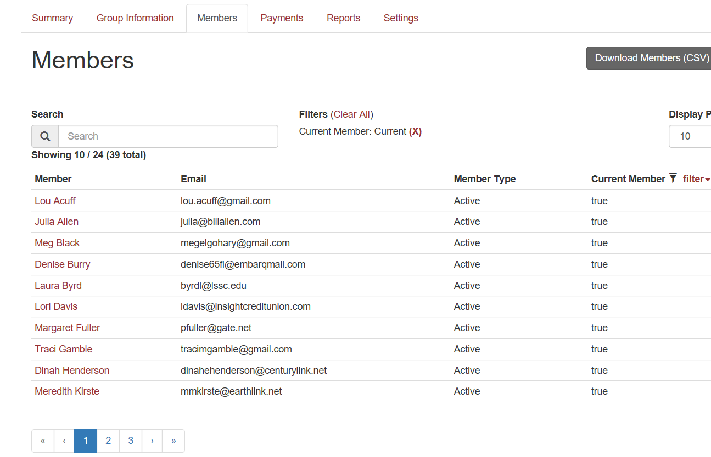
Locate existing members to edit by Search bar
or clicking on their Name on the Members page

Slide 14
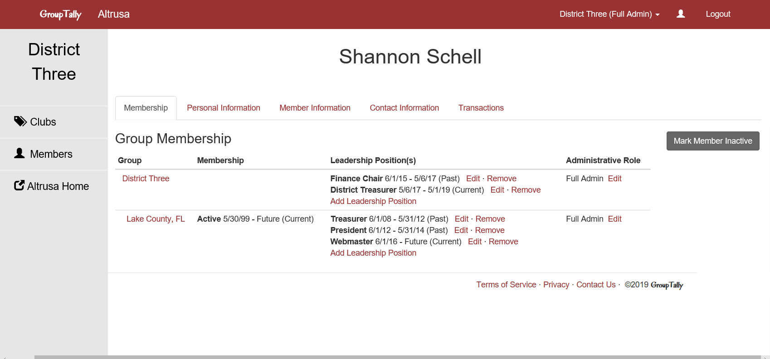
From the members page you can update
Personal Information, Member Information, Contact Information and see Transactions
of Dues and Fees, click Edit.

Slide 15
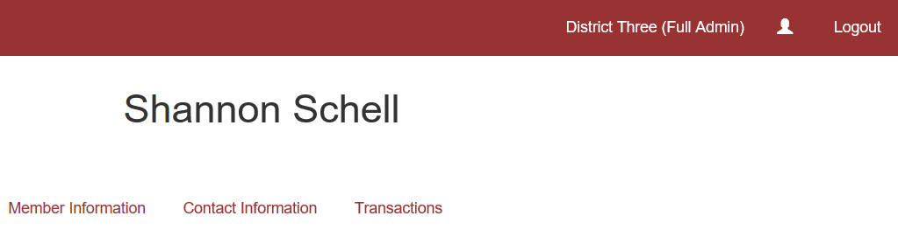

Payment
Method
These are the ways to make a payment
For District Fifteen you can either make a payment by credit card or by online payment (this method will require assistance from the Accounting Assistant at Altrusa International.
Link credit card, first as Club Treasurer go to YOUR member page, click silhouette in upper right corner of red bar.

Slide 16
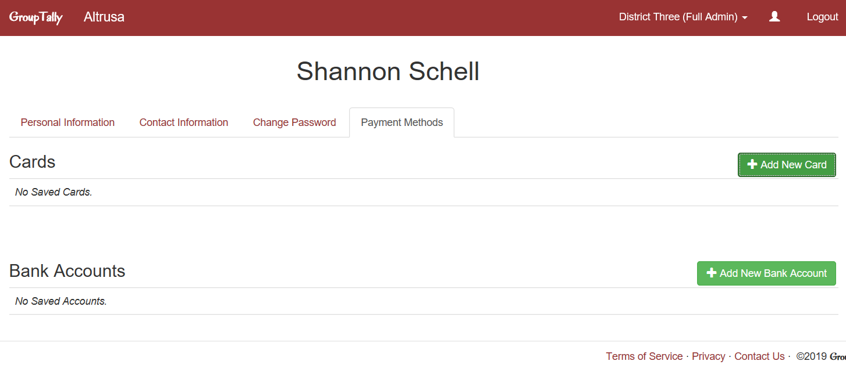
You will see a page with your name at the top,
and a few tabs will be available. Choose Payment Methods tab.
If paying by credit card, click “Add Card”

Slide 17
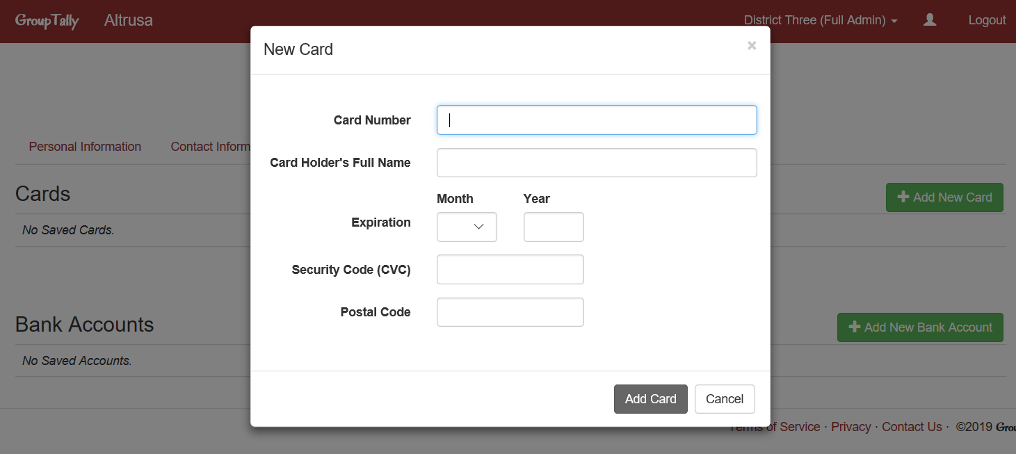
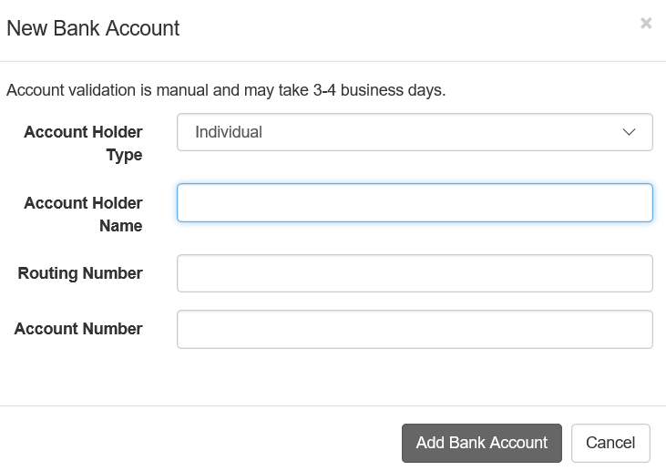
On this page, you see payment method previously entered, or it may be blank. To link a credit card, click on + Add New Card, (ignore the Add New Bank Account section). A dialogue box will appear for you to fill out.

Slide 18
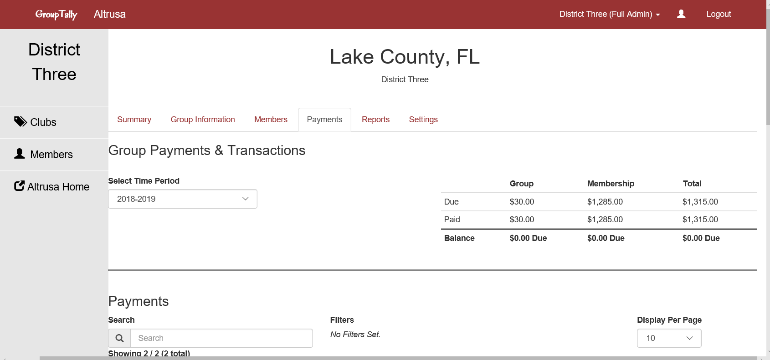
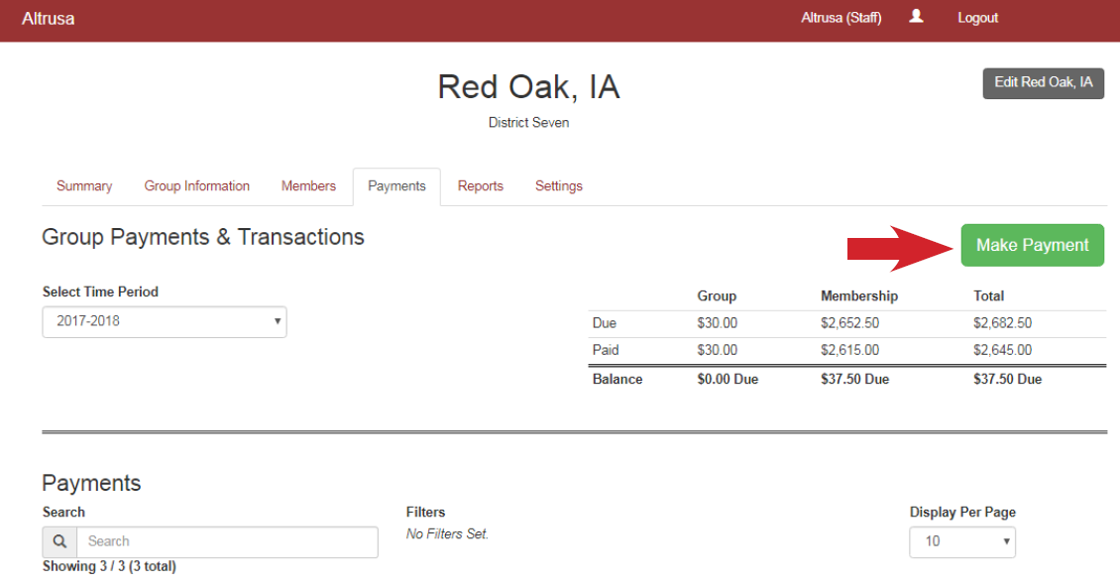

Making a Payment
The Payments page is divided into four sections.
Group Payments, Payments, Group Transactions, and Member Transactions.
If you have a balance, the Make Payment button will be available to you. No Balance No Button.
If Balance Due CLICK
Payment button

Slide 19
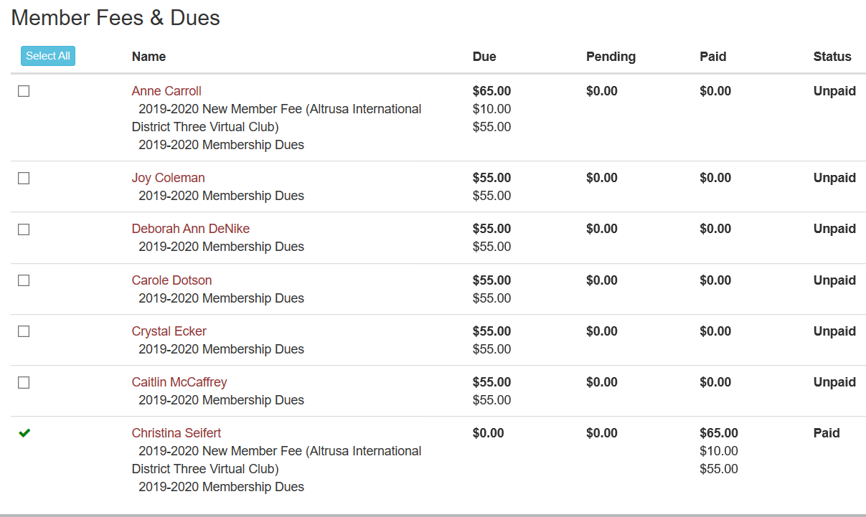

On payments page you will find a list of dues, those with green check marks have been paid, and open check boxes are unpaid and available for selection.

Slide 20
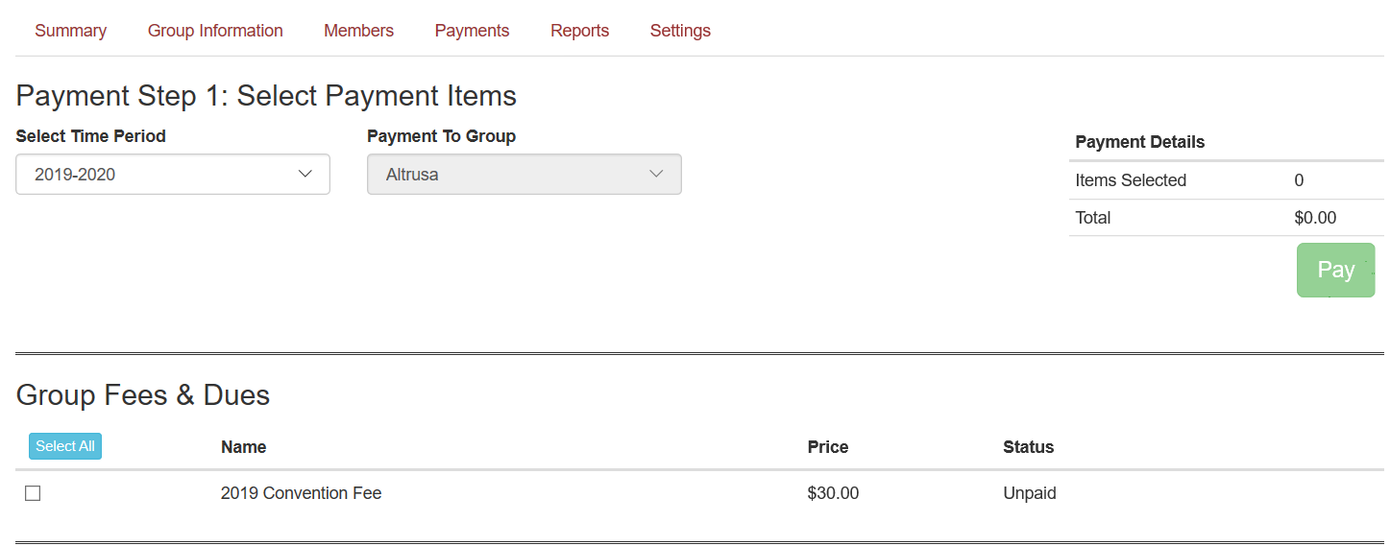
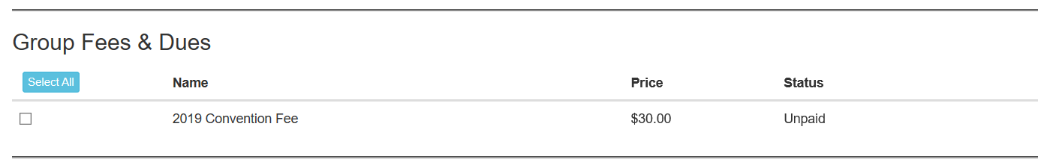
Select
Members
and
Items to
Pay
When Selection is made click Pay Button

Slide 21
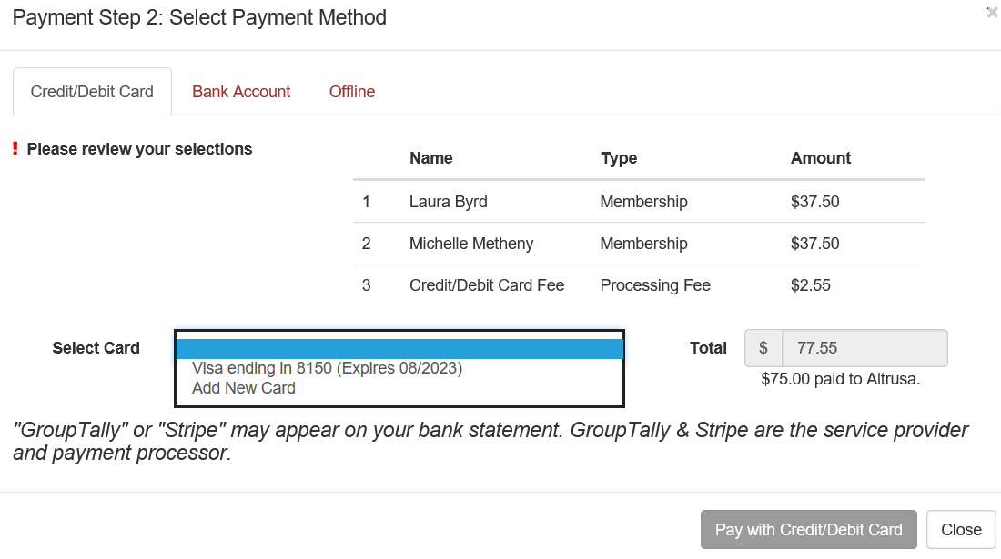
Once you click pay button, select Credit/Debit Card.
Click on “Pay with Card” (the Bank A/c Method is only available to US clubs)
Payment Options

Slide 22

Financial
Responsibility
Financial Duties
Plan annual budgets.
Receive, record and deposit funds in approved Club accounts and maintain records of those accounts.
Pay all Club bills and dues that have been AUTHORIZED by the Board in a timely manner.
B. Dues and Fees
Familiarize yourself with International and District financial policies and procedures.
Collect and submit dues to International and District in accordance with deadlines. All must be RECEIVED by June 15. Do not pay before 1 June.

Slide 23

Financial
Responsibility
C. Financial Reports and Records
Report on financial matters at each business meeting, Club Board, Club’s annual meeting and on request.
D. Members on “Leave of Absence”
Sometimes members are not able to regularly attend meetings. Events in their lives change and their schedules can get overwhelming. Granting a leave of absence is a matter between the member and the Club. Members on leave MUST still pay their dues to remain Active members.

Slide 24

A.
Financial
Duties
Plan Annual Budgets
Our financial year is 1st June – 31st May.
Develop budget with Finance Committee, approved by Club Board,
presented to club once approved. Ideally all before 1st May. The
general operating budget is based both on anticipated income from
dues and membership processing fees and on estimated fundraising
and donor income.
The general operating budget must provide for the following operating expenses:
International Dues
Membership processing
District Dues
International Convention Fees
Club Officer/Committee expenses
Fixed Operating Expenses (PO Box Rental, Web Site Hosting, etc.)
General office supplies and postage
Delegates expenses for District Conferences
Delegates expenses for International Convention
A SAMPLE BUDGET is shown in the Treasurers Guide

Slide 25

B.
Dues
and Fees
Timely Collect and Submit Dues
The Club Treasurer is responsible for invoicing each member at least one month in advance for upcoming Dues Renewal and submitting all dues payments and fees (convention fees, district conference fee, reinstatement fees and new member processing fees) to International and District by the June 15 deadline. If payment is not received by the deadline each member of the Club will be subject to a late fee. The Club Treasurer is responsible for submitting late fees with late dues to International of $5.00 (or $10.00 after July 10) and District of 10% of annual District Due after June 15.
Please do not pay prior to 1 June.
Dues payments are non-refundable. Do NOT advance payments on behalf of members.
We recommend that you do not wait until every member has paid their dues before submitting them because you risk incurring a late fee for every member. Send the payments you have received so that members who paid on time are not penalized.
Club Treasurers are responsible for submitting ALL Dues/Fees

Slide 26
Paying Dues by Visa or Int Money Transfer
You can pay your dues via Visa in Group Tally – and then reimburse the visa holder.
Or you can transfer money via International Money Transfer. The details you need are on this slide and the following slide
This is the information sent to us by Altrusa International to set up a deposit for Altrusa International
  ACH Routing: 071000013
  Wire Routing: 021000021
  Acct Number: 788592183
  A hint here is to be sure to mark in the Other Bank Charges that the “Beneficiary to pay”
  Also advise in Group Tally that payment will be made by Bank Transfer (also handy to advise International Office via email to Altrusa@altrusa.org
  The minimum amount you can transfer using this method is $100.

Slide 27
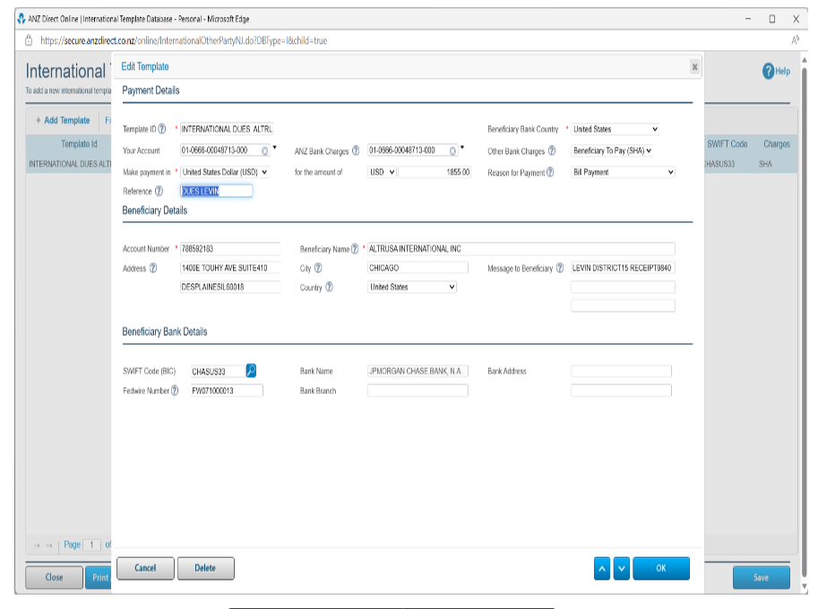
Paying Dues by Visa or Int Money Transfer

Slide 28
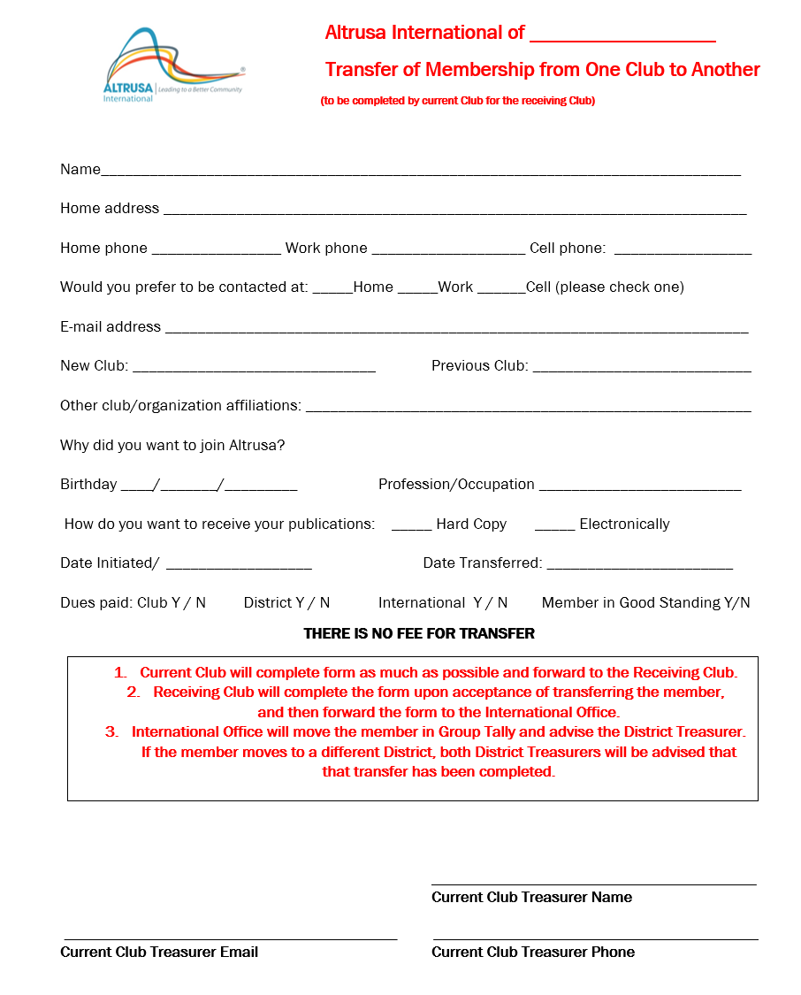
MEMBER
Transfer
Form

Slide 29
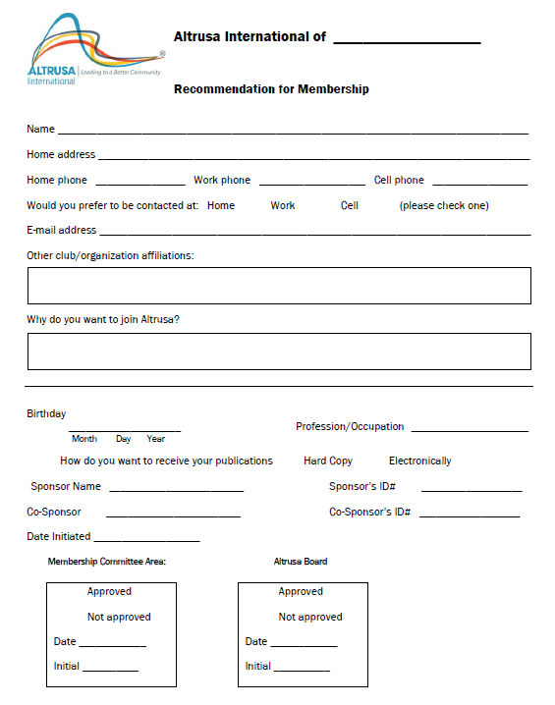
MEMBER
Recommend
Form

Slide 30

C.
Charities
Commission
FILE ANNUAL RETURN
Nearly all of District Fifteen’s Altrusa clubs are registered with the Charities Services. The Charities Act 2005 requires all charities registered with the Charities Services to file an annual return within six months of balance date (financial year end). The financial year for clubs is from 1 June – 31 May each year so you need to have filed your annual return by 30 November of that year. The return includes:
Entity Information (purpose/mission statement, officers, etc)
Statement of Service Performance (non-financial outputs and outcomes)
Statement of Receipts and Payments (profit or loss)
Statement of Resources and Commitments (balance sheet)
Notes to your Performance Report (explains financial information)
Log in to www.charities.govt.nz and click on Annual Returns and follow through the prompts find a template under Resources to fill in as an excel spreadsheet and then upload to the site as a PDF. An annual fee is payable on submitting the return if the club’s gross income is $10,000. The fee is cheaper if the financial return is submitted online rather than by post.

Slide 31

CYBER
FRAUD
Please be AWARE of the existence of cyber fraud
Be careful when making payments and vigilant regarding not only AUTHORIZING payment but ensuring the RECIPIENT’s Identity. We have had incidents where District Treasurers were asked to make a payment by an email from their Governor. It will appear to be the Governor’s email address but will be slightly different. Do NOT respond or click on any “links”. We recommend you call your Governor to verify payment.
We are concerned that this fraudulent activity could impact Club Treasurers. Please ensure you do not provide financial information or passwords to anyone via email, as email accounts can be hacked. If unsure about a payment request, we suggest you pick up the phone and talk directly with your Club President. Remember if it seems strange, do some extra verification!

Slide 32

CYBER
FRAUD
To protect yourself, we urge you to:
Periodically change your passwords and use two factor
authentication whenever possible
Monitor online banking – report suspicious activity
Monitor email accounts – if any unusual activity, update
anti-virus software
Be wary of international phone calls of unknown origin
Be wary of clicking on links and attachments from senders
you do not recognize and even some you do
Do not wire or send funds without authenticated authorization !!

Slide 33


Resources
Altrusa International Website: www.altrusa.org
Altrusa District Fifteen Website: www.altrusa.org.nz
District Fifteen Treasurer: treasurer@altrusa.org.nz
District Supplies Officer: supplies@altrusa.org.nz

Slide 34

FOR YOUR SERVICE TO ALTRUSA

